Slide 1
Intro to Open Source
Presented by QC Coders

Slide 2
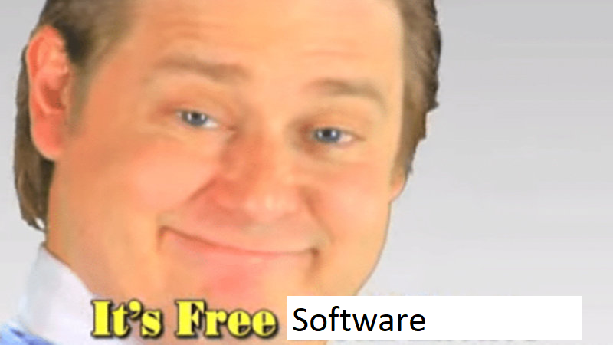
What is Open Source?

Slide 3
What is Free Software?
Computer software distributed under terms that allow users to run the software for any purpose as well as to study, change, and distribute it and any adapted versions
Four Freedoms:
Freedom 0: The freedom to run the program for any purpose.
Freedom 1: The freedom to study how the program works, and change it to make it do what you wish.
Freedom 2: The freedom to redistribute and make copies so you can help your neighbor.
Freedom 3: The freedom to improve the program, and release your improvements (and modified versions in general) to the public, so that the whole community benefits.

Slide 4
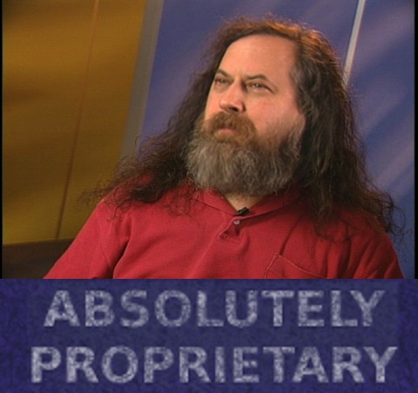
The Opposite of Proprietary

Slide 5
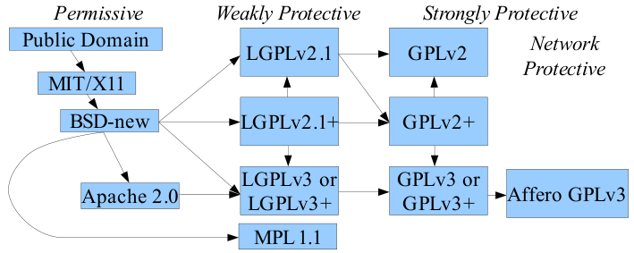
Licensing

Slide 6
Common Questions
Can I charge money for my software?
Yes! You’re free to do as you wish; it’s your software. Keep in mind though, that you must provide the source code to buyers, and they are free to redistribute both the source code and binaries however they like.
Nothing is stopping the first buyer from giving your software to everyone else.
How can I make money, then?
Successful Open Source business models usually give software away while charging for documentation, support, and training.
You may change your license, for example, by removing the ‘copyleft’ provision in exchange for a fee. This is called dual licensing and allows your free software to be used in proprietary ways.

Slide 7
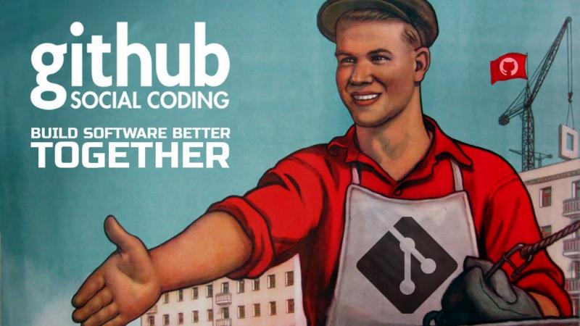
Questions?

